Slide 1



PRELUMENS:A WEB-BASED
LEARNING MANAGEMENT SYSTEM FOR MICROENTERPRISE PRESCHOOL
Researchers
CELINE JOIE V. BUENAVENTURA
ALEA B. FROGOSA
Group 4604
Computer Engineering Practice and Design II

Slide 2

Statement of the Problem
The problem that this study attempts to solve is the uninteresting learning environment and poor interaction among individuals participating in preschool learning, particularly in these times where all academic process is conducted remotely
4604
POLYTECHNIC UNIVERSITY OF THE PHILIPPINES

Slide 3
Statement of the Problem
How will the proposed system improve:
1.1. Learner’s academic performance, character and behavior?
1.2. Teacher and parent experience?
1.3. Teacher-Learner relationship?
1.4. Teacher-Parent relationship?
How will the proposed system aid the following aspect of remote learning:
2.1. Learning process
2.2. Learning assessment and evaluation
2.3. Learning engagement
4604
POLYTECHNIC UNIVERSITY OF THE PHILIPPINES

Slide 4
Statement of the Problem
3. What will be the evaluation of the proposed mobile application in terms of:
3.1. Functionality
3.2. Reliability
3.3. Usability
3.4. Performance efficiency
3.5. Compatibility
3.6. Security
3.7. Maintainability
3.8. Portability
4604
POLYTECHNIC UNIVERSITY OF THE PHILIPPINES

Slide 5
Scope
For Microenterprise Preschools
Accounts: Student
and/or Parent,
Teacher, Administrator
Username policy
Audio and video
learning tools
Virtual classroom
with multiple subjects
Chatroom for parent-teacher consultation
Assessments in
flashcard forms
Manual Grading
Screen time Timer
4604
POLYTECHNIC UNIVERSITY OF THE PHILIPPINES
Notes:
The scope of the study will be the following:
Development of a mobile-based learning management system for microenterprise preschools.
Offer online learning and academic engagement.
Three different accounts will be generated: student and/or parent, teacher, administrator.
Distinct functionality of the application depending on the type of account.
Username policy will be depending on the client.
Utilization of virtual classroom where students and learner can interact with each other.
A classroom can have multiple number of subjects included. Teachers can create their own learning tools, and there will be some already available in audio and video format.
Assessment can be customized depending on what kind of answers the teacher anticipates.
Assessment will be in form of flash cards
Assessment will be manually graded by the instructor
There will be a chatroom for parent-teacher consultation.
All activities will be timed to limit preschooler’s screen-time.

Slide 6
Limitations
Exclusively
for preschool
institution
Preschool Resources
and contents
No financial
transaction
Teachers and students/parents
can’t create their own account
Username
policy
Non-admin
accounts
Customization
One instructor
per course
Auto-assessment will
not be implemented
The system is only
available online
4604
POLYTECHNIC UNIVERSITY OF THE PHILIPPINES
Notes:
The study is limited to the following:
Designed specifically and exclusively for preschool institution.
Resources and contents are for preschool academics only.
The system doesn’t account for any financial transaction.
Teachers and students/parents can’t create their own account.
Username policy will depends on what the client wants. Non-admin accounts can only alter the profile's basic details, excluding the username.
Only one instructor per classroom.
Auto-assessment will not be implemented
Messaging feature is exclusive for the specific preschool institution
The system is only available online

Slide 7
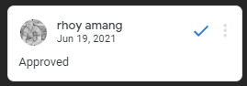
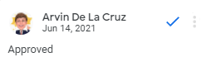
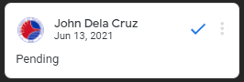
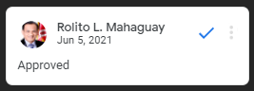
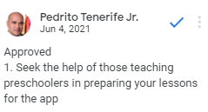
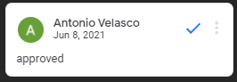
Project Proposal
First Thesis Project:
The Development of a Mobile-Based Learning Management System for Microenterprise Preschools
4604
POLYTECHNIC UNIVERSITY OF THE PHILIPPINES

Slide 8
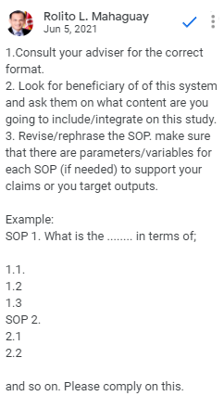
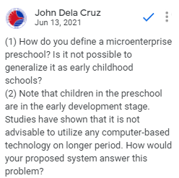
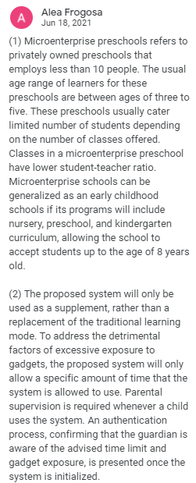
Project Proposal
4604
POLYTECHNIC UNIVERSITY OF THE PHILIPPINES

Slide 9
Methods of Research
Feedbacks
Panelist | Comments | Suggestions
DR. REMEDIOS G. ADO Panel Chair | Revise the MOR Paper to align with the concept suggested by the panel | Consult an expert in the field of child development or Pre-school teacher. Include in the study the effects on using mobile screen to a child. Make the system as a tool of a pre-school teacher. Look for a specific stakeholder who can help you in the scenario setting.
ENGR. JOHN R. DELA CRUZ Panel Member 1 |  | Strongly consider the philosophy and development psychology in the development of the LMS Consider the aspect that it needs supervision, and the assurance of it.
ENGR. JONATHAN C. MANARANG Panel Member 2 | Preschoolers must have full guidance of parent/guardian while on mobile. Must have a catchy topic, not boring. Exams must be similar to games or playing mode.
4604
POLYTECHNIC UNIVERSITY OF THE PHILIPPINES

Slide 10
Project Design I
Milestones
This is when the researchers decided to change the platform from mobile to web
The researchers focuses on the development of the system
The word “Prelumens”, which means “initial light”, was chosen as the system’s name
Revisions of Chapters 1-3
4604
POLYTECHNIC UNIVERSITY OF THE PHILIPPINES

Slide 11
Methods of Research
Feedbacks
Panelist | Verdict | Suggestions
ENGR. FERDINAND O. NATIVIDAD | Passed | Welcome Banner Feedbacks for parents Assurance that the students are the one taking up the activities in the LMS. Copyright Issues
ENGR. CHRISTIAN BART F. SADIWA | Passed | Choose a proper term for “username policy” Send email to registered students and instructor “Protected Routes” should be “Protected URL/URI”
4604
POLYTECHNIC UNIVERSITY OF THE PHILIPPINES

Slide 12
Status of the Research
Development of the System
70%
Overall Progress
60%
Documentation
50%
4604
POLYTECHNIC UNIVERSITY OF THE PHILIPPINES

Slide 13
Current Progress
of the System
4604
POLYTECHNIC UNIVERSITY OF THE PHILIPPINES

Slide 14
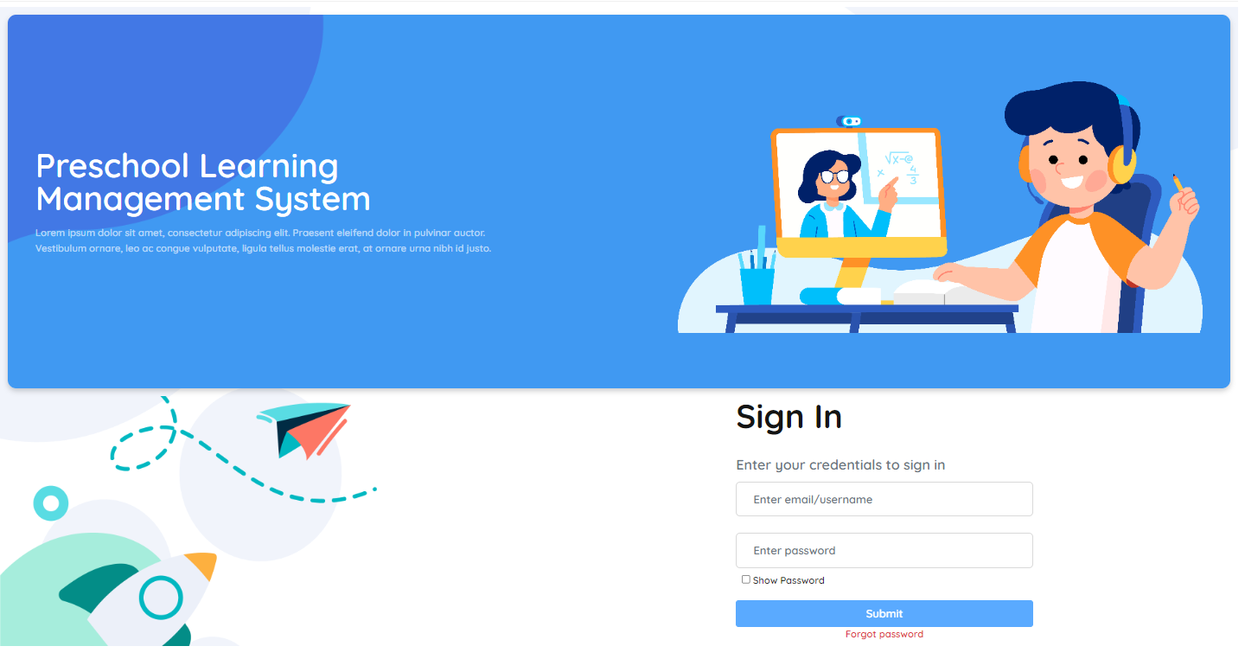
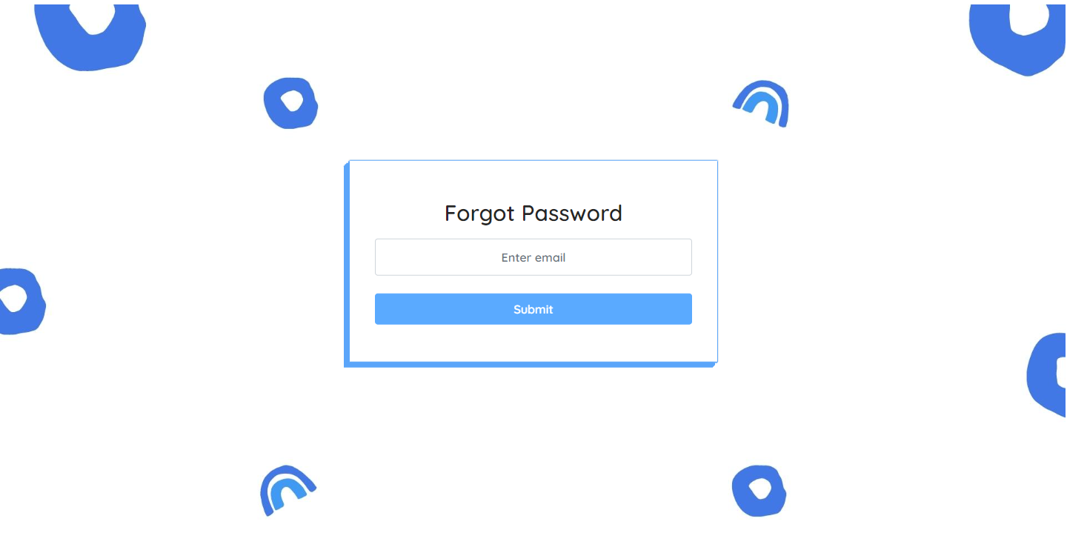
General Pages
Login Page
Forgot Password Page
4604
POLYTECHNIC UNIVERSITY OF THE PHILIPPINES

Slide 15
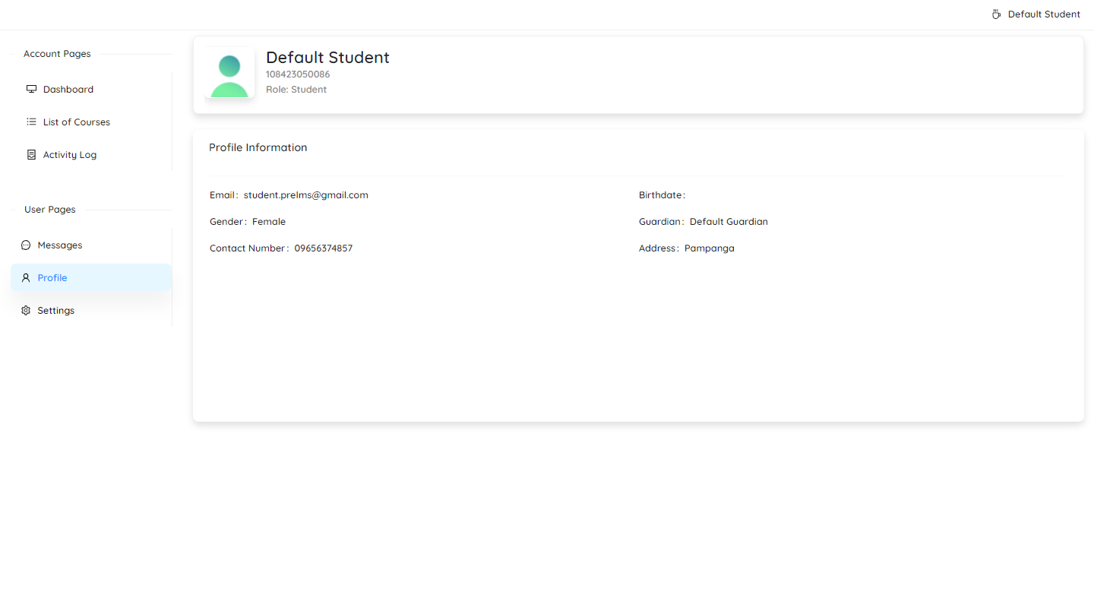
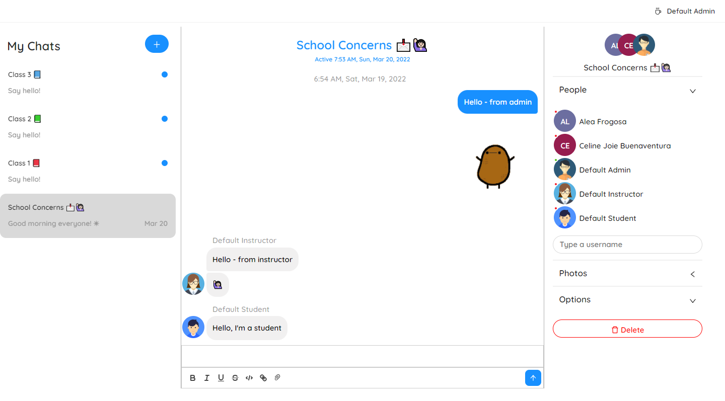
General Pages
Profile Page
Chatrooms
4604
POLYTECHNIC UNIVERSITY OF THE PHILIPPINES

Slide 16
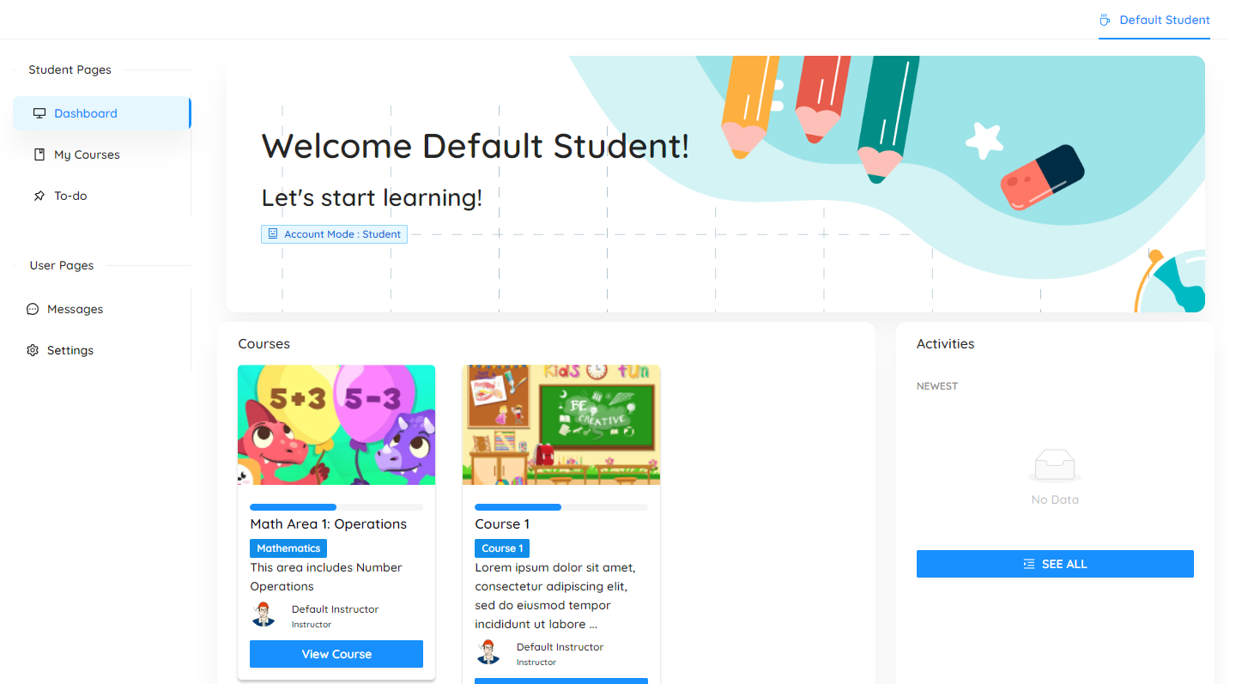
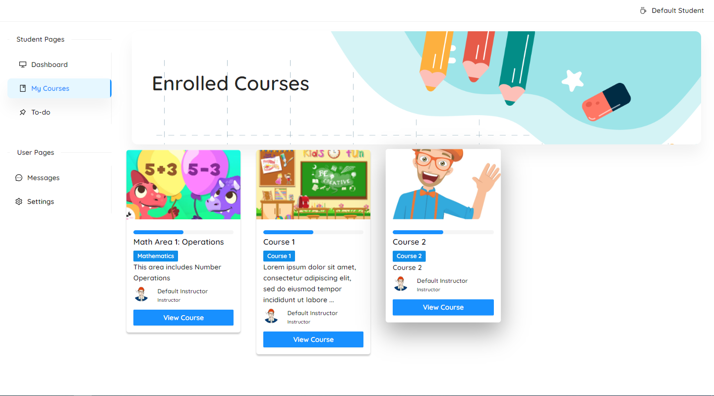
Student Pages
Dashboard
Enrolled Course
4604
POLYTECHNIC UNIVERSITY OF THE PHILIPPINES

Slide 17
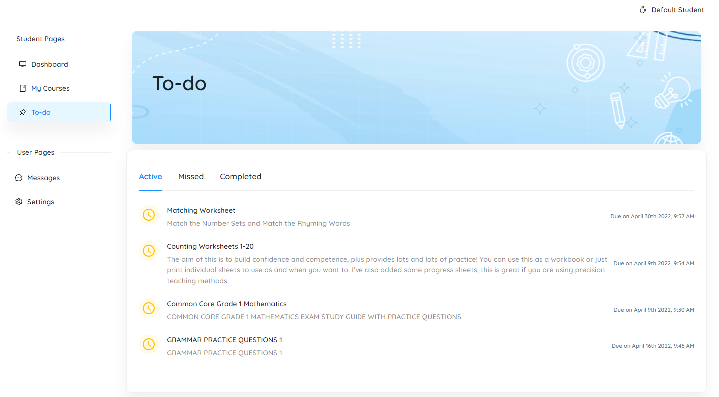
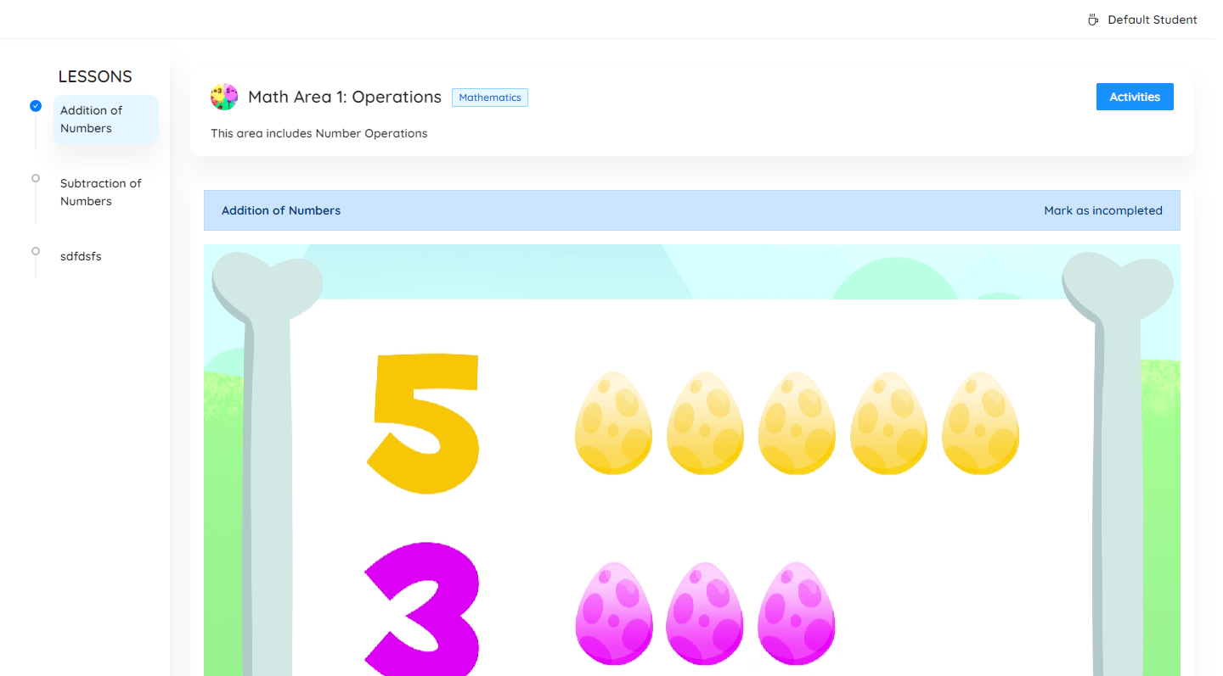
Student Pages
List of Activity Page
Course View Page
4604
POLYTECHNIC UNIVERSITY OF THE PHILIPPINES

Slide 18

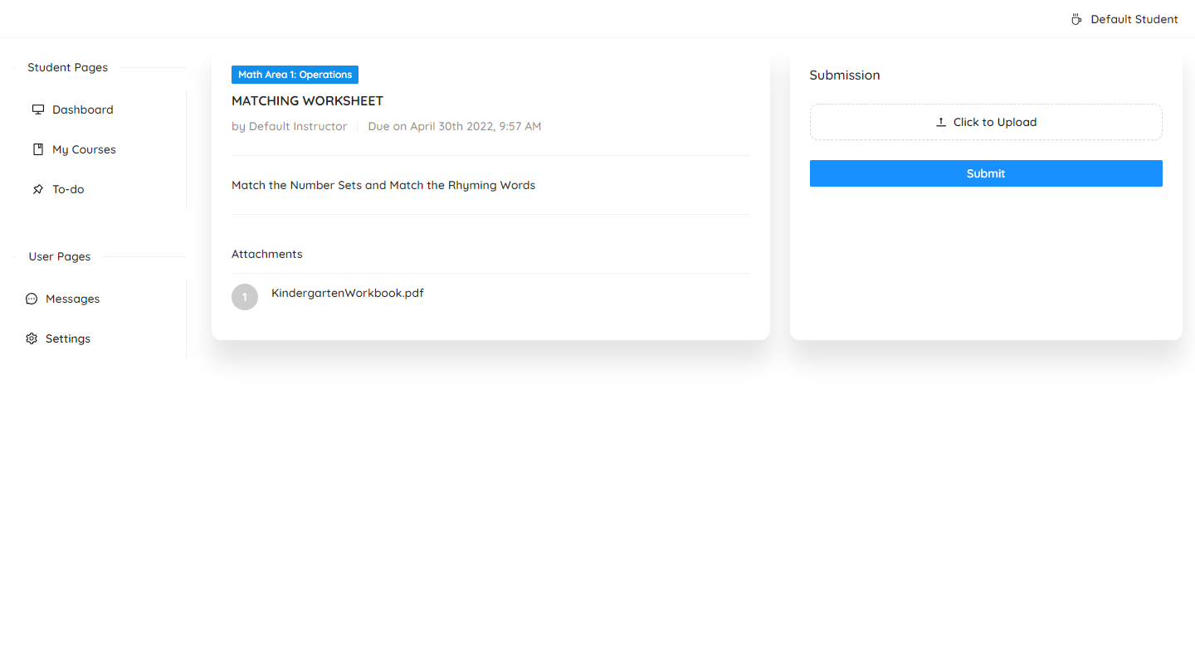
Student Pages
Time out Screen
Assignment View Page
4604
POLYTECHNIC UNIVERSITY OF THE PHILIPPINES

Slide 19
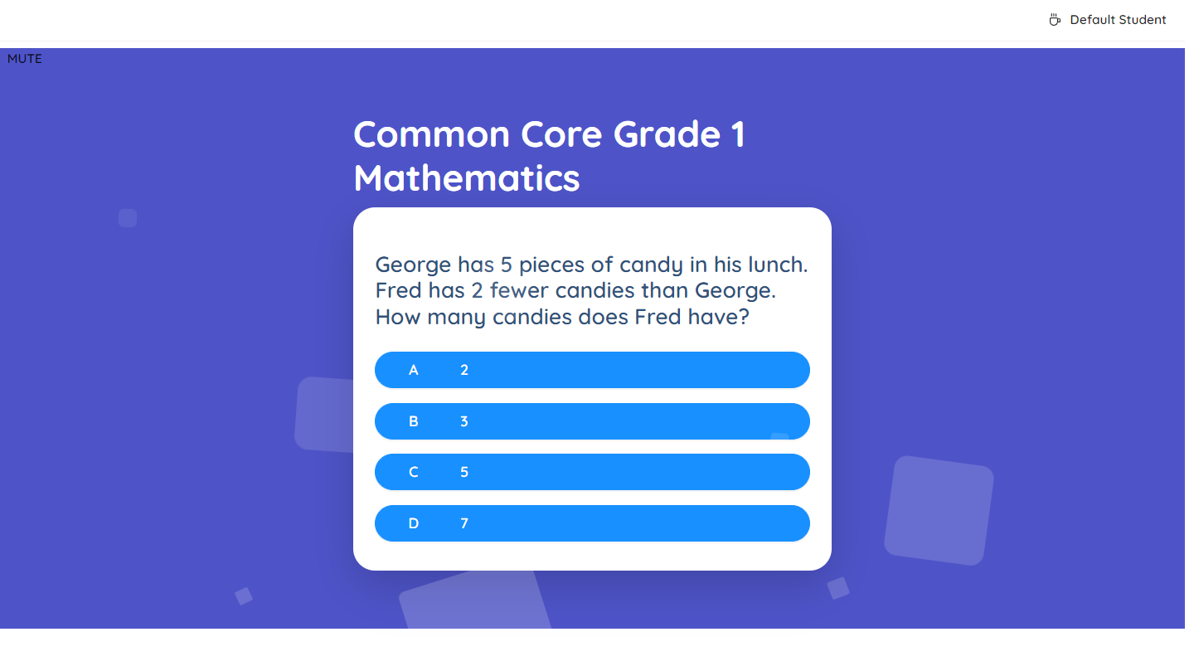
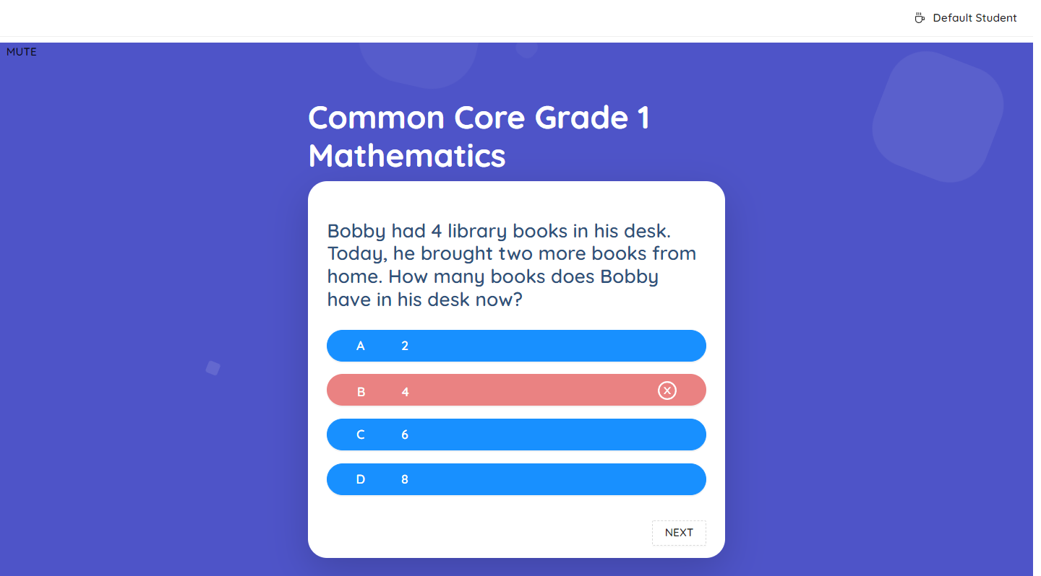
Student Pages
Interactive View Page
4604
POLYTECHNIC UNIVERSITY OF THE PHILIPPINES

Slide 20
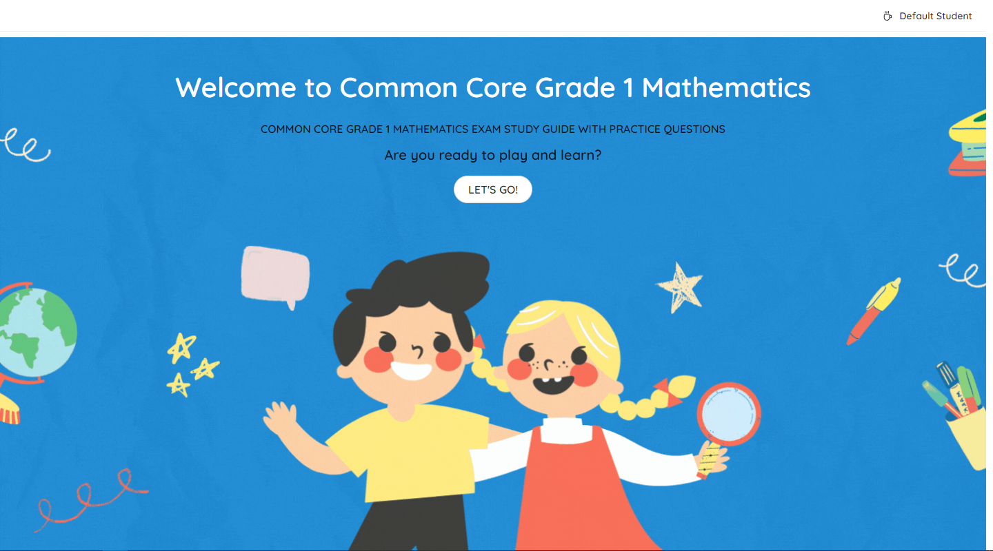
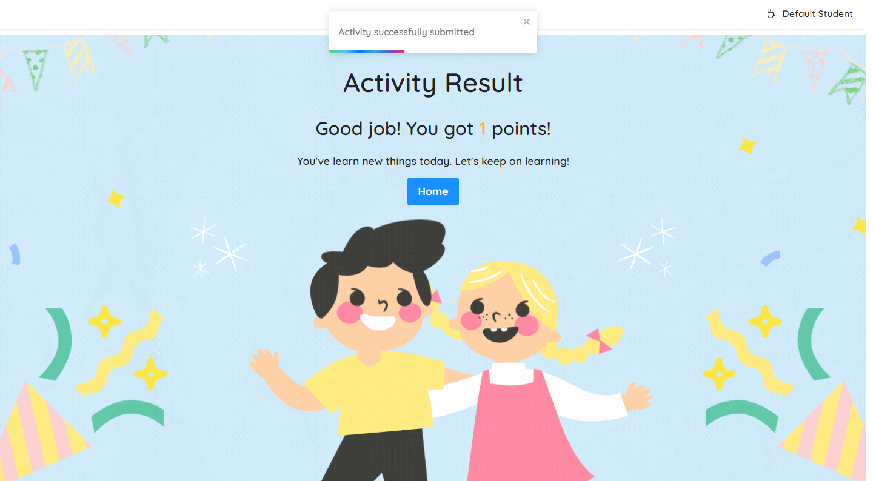
Student Pages
Interactive Start Page
Interactive Results Page
4604
POLYTECHNIC UNIVERSITY OF THE PHILIPPINES

Slide 21
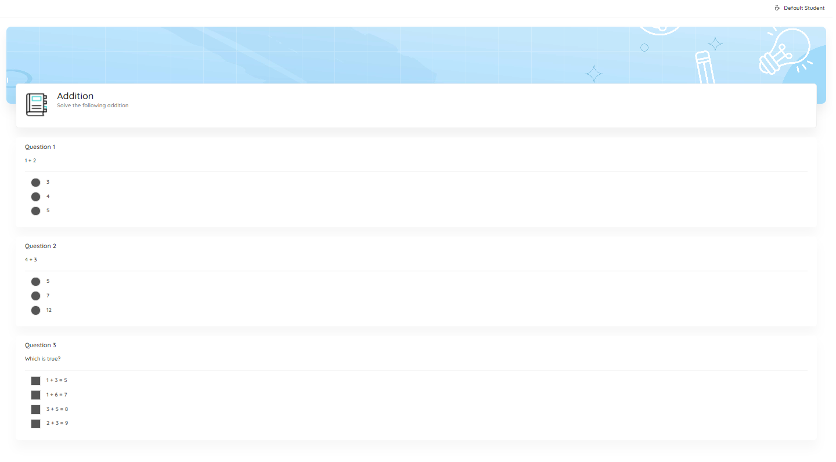
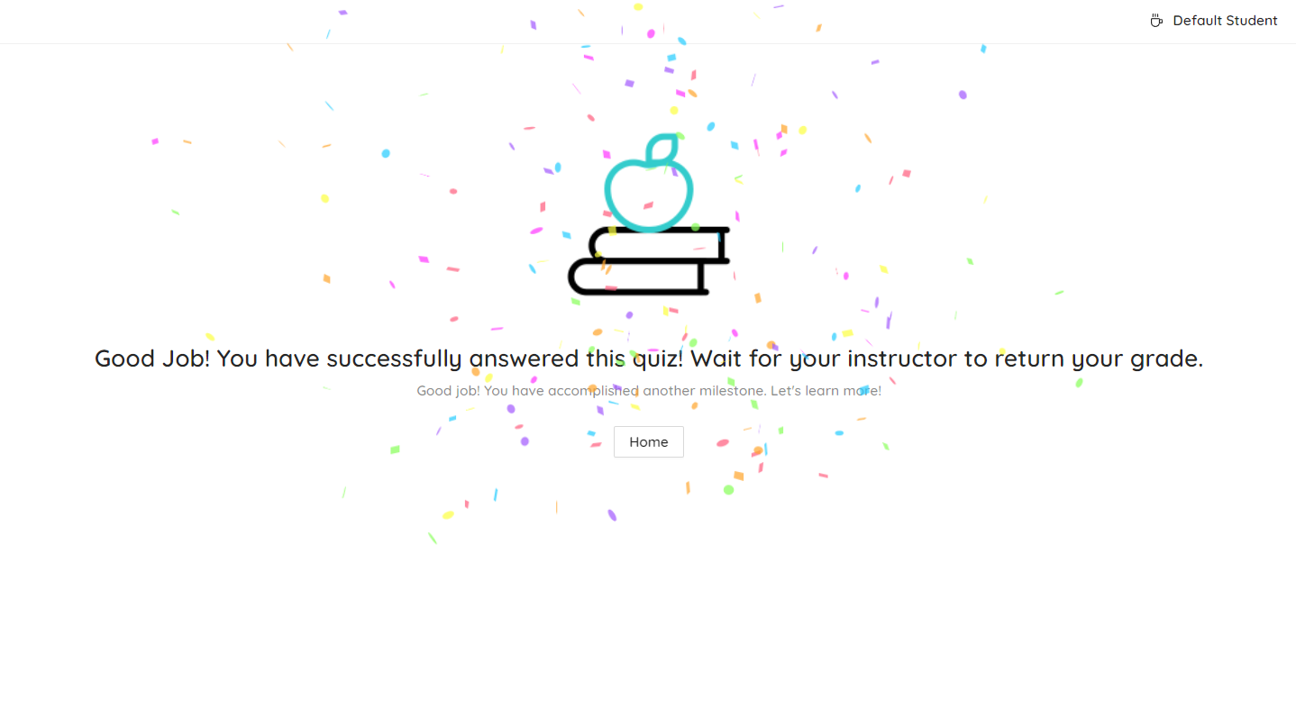
Student Pages
Quiz View Page
Quiz Result Page
4604
POLYTECHNIC UNIVERSITY OF THE PHILIPPINES

Slide 22
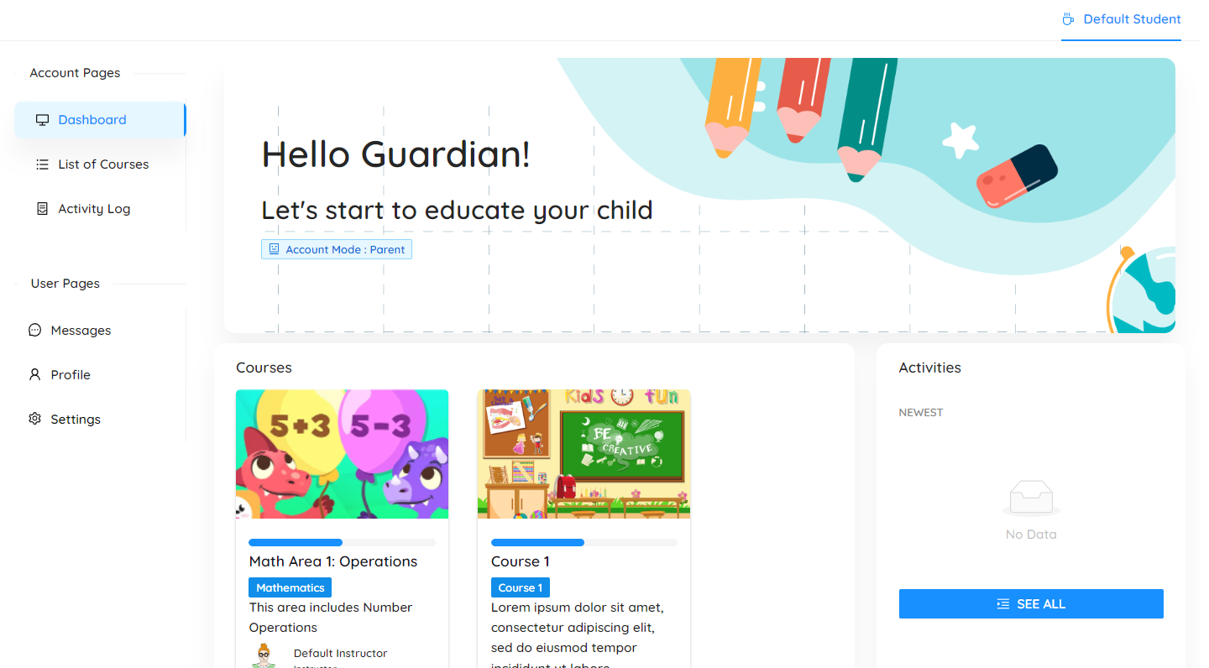
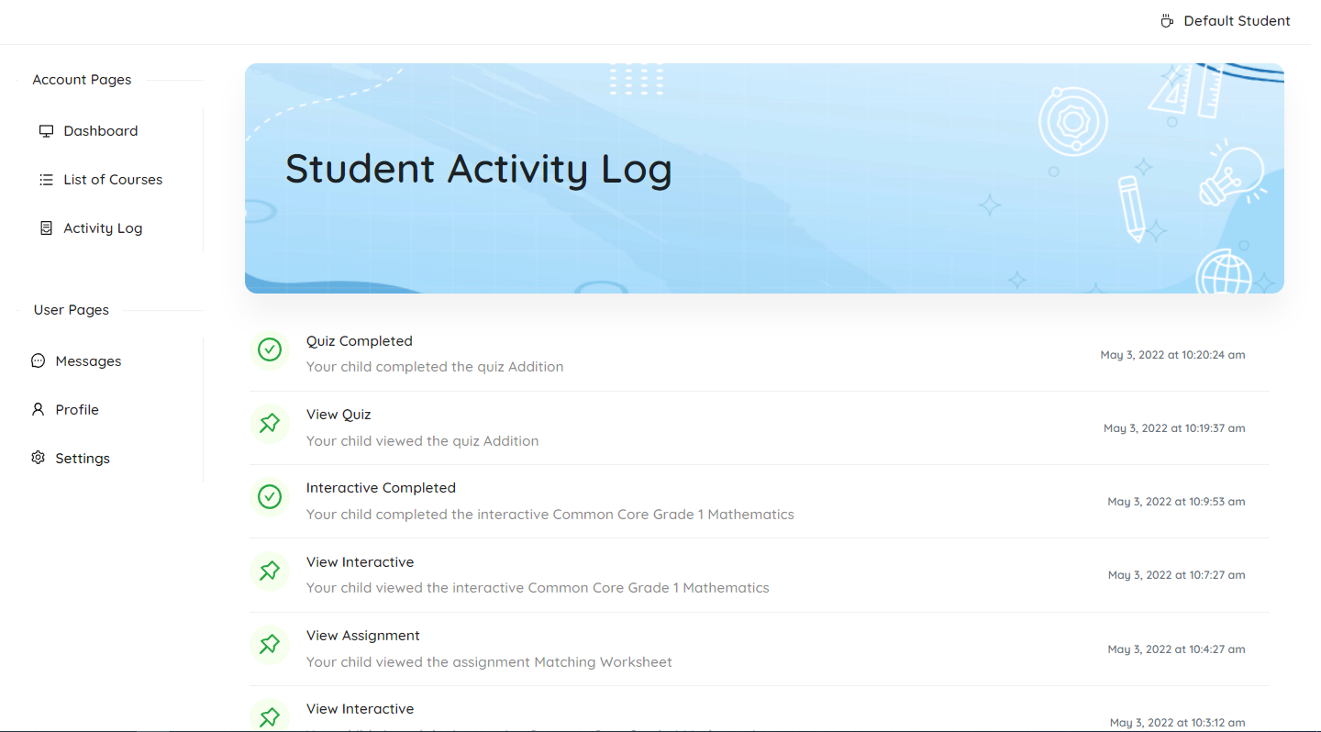
Parent/Guardian Pages
Dashboard
Student Activity Log Page
4604
POLYTECHNIC UNIVERSITY OF THE PHILIPPINES

Slide 23
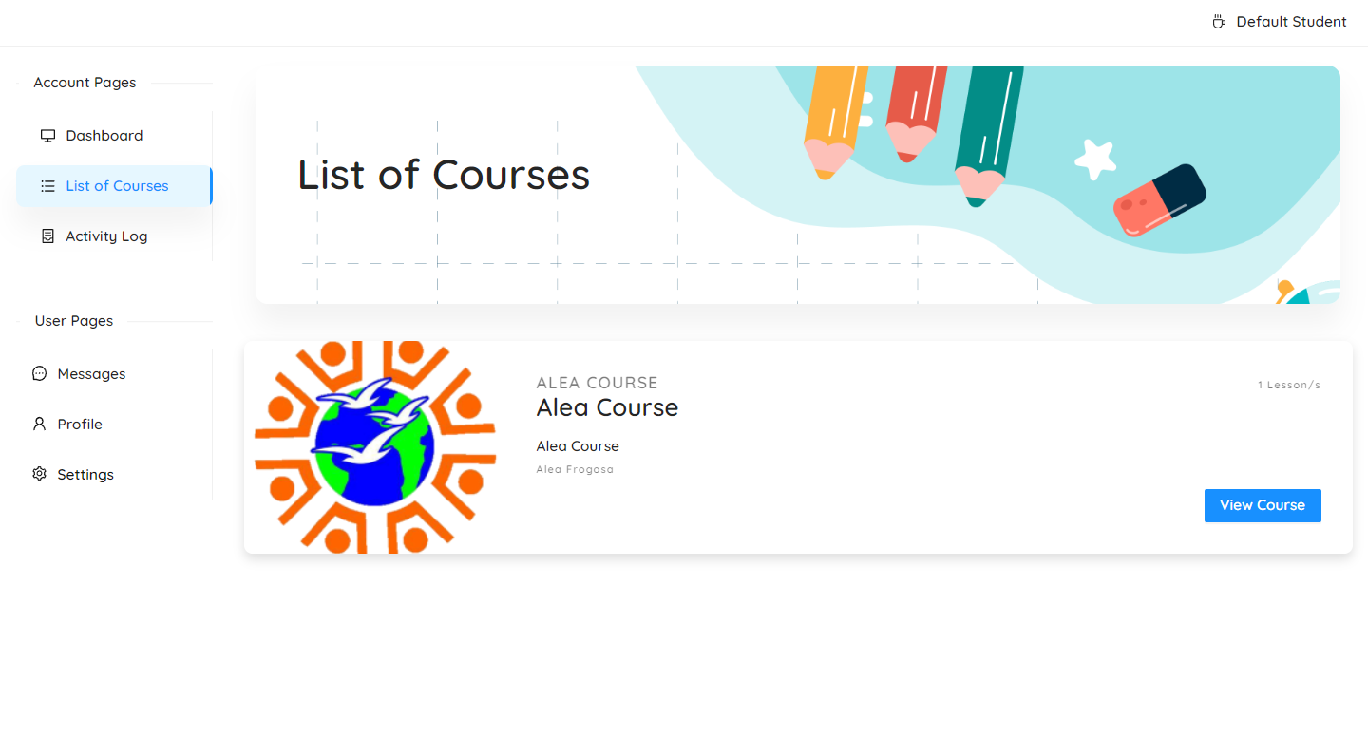
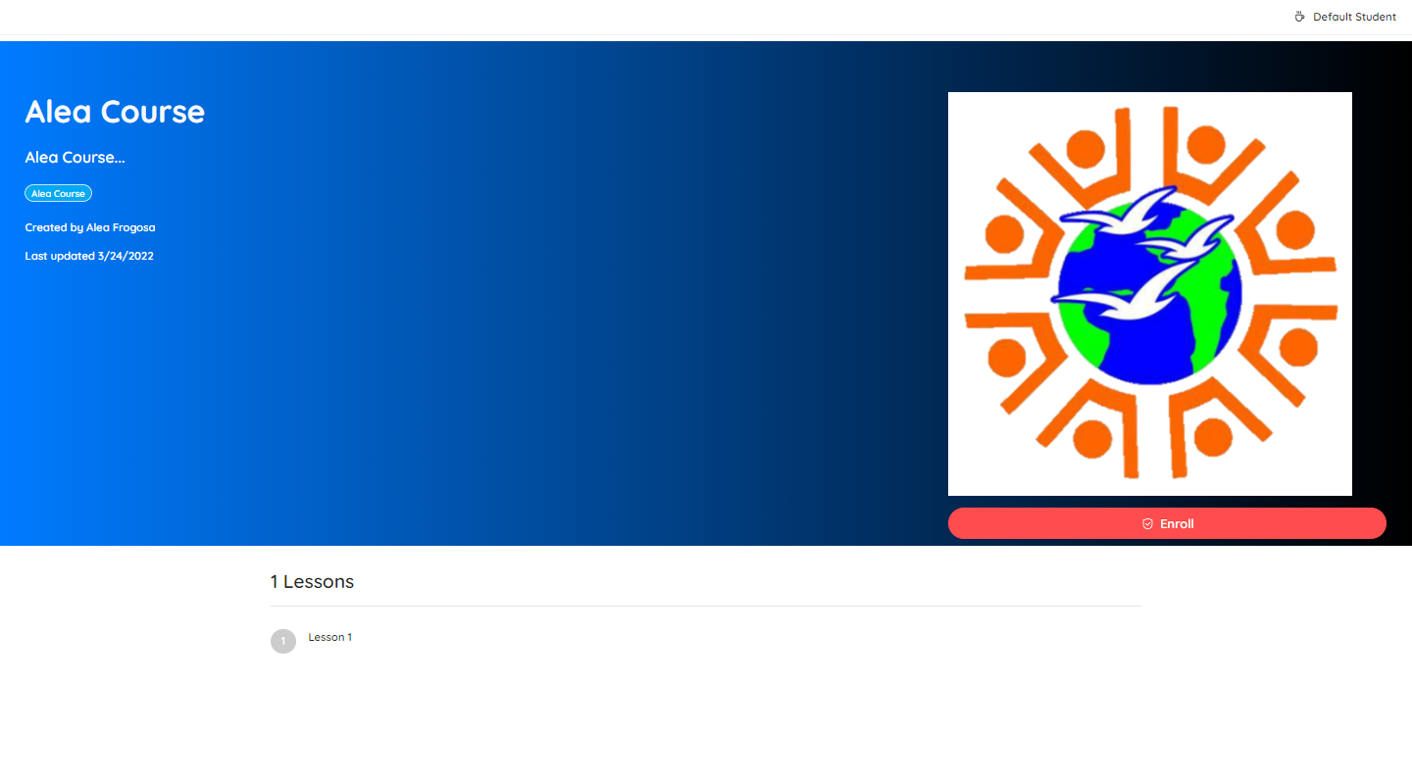
Parent/Guardian Pages
List of Courses Page
Course View Page – for Enrollment
4604
POLYTECHNIC UNIVERSITY OF THE PHILIPPINES

Slide 24
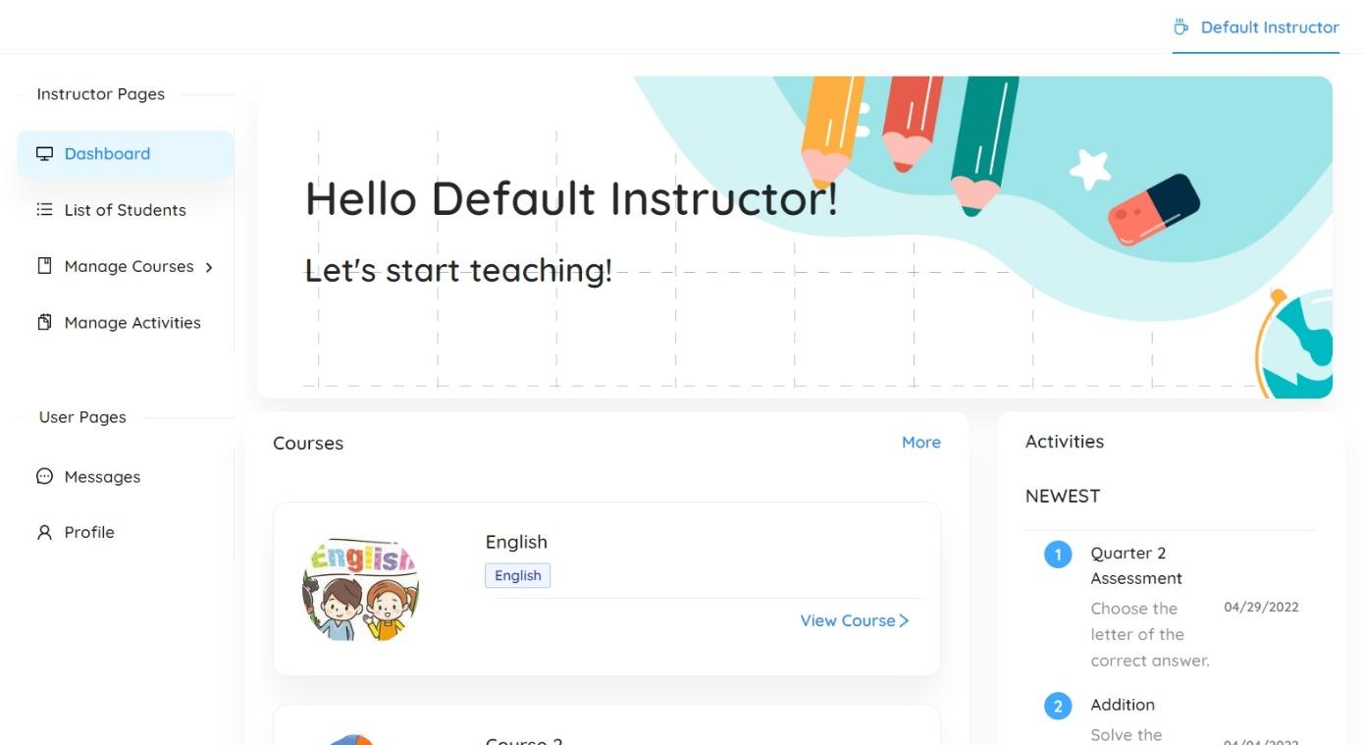
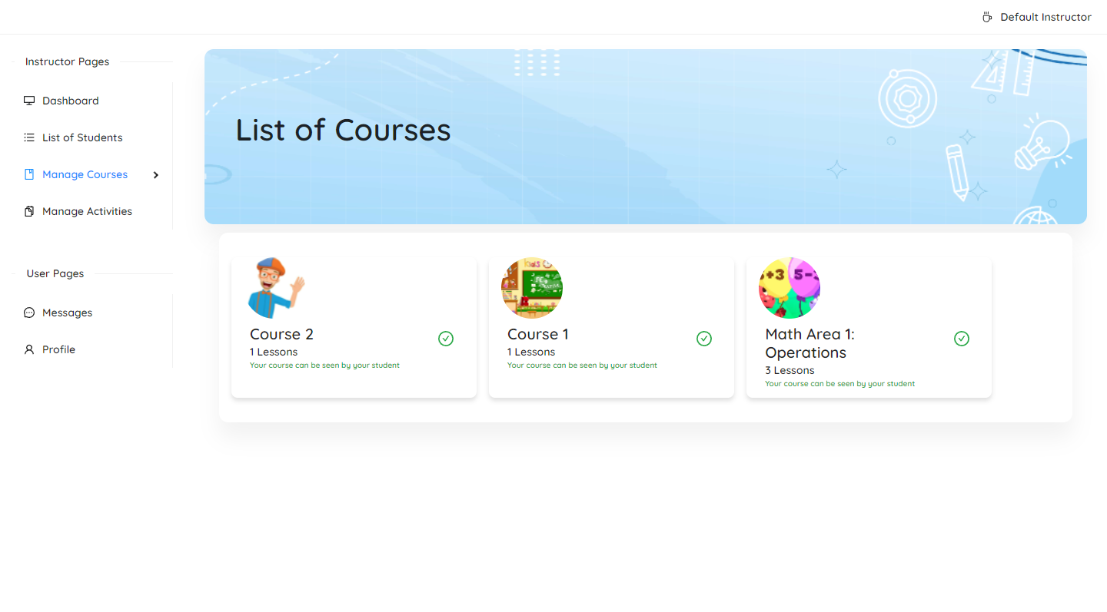
Instructor Pages
Dashboard
List of Course Page
4604
POLYTECHNIC UNIVERSITY OF THE PHILIPPINES

Slide 25
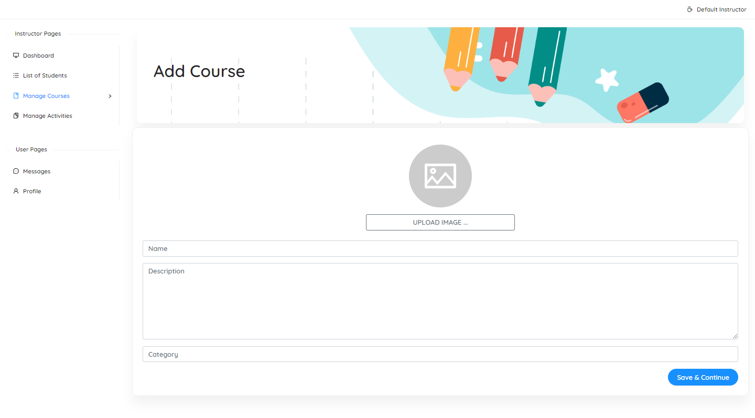
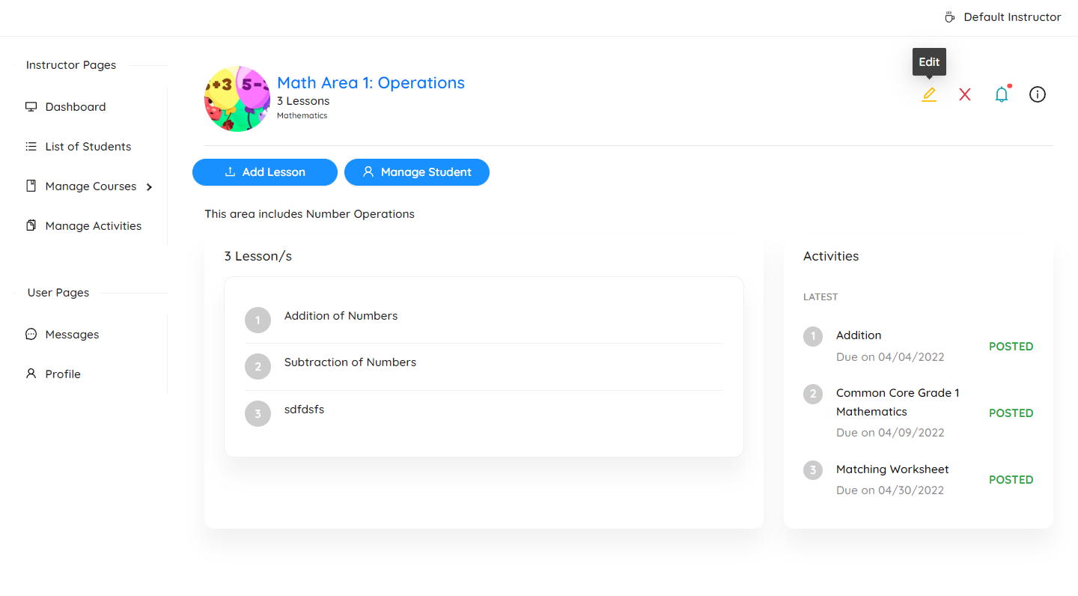
Instructor Pages
Create Course Page
Course View Page
4604
POLYTECHNIC UNIVERSITY OF THE PHILIPPINES

Slide 26
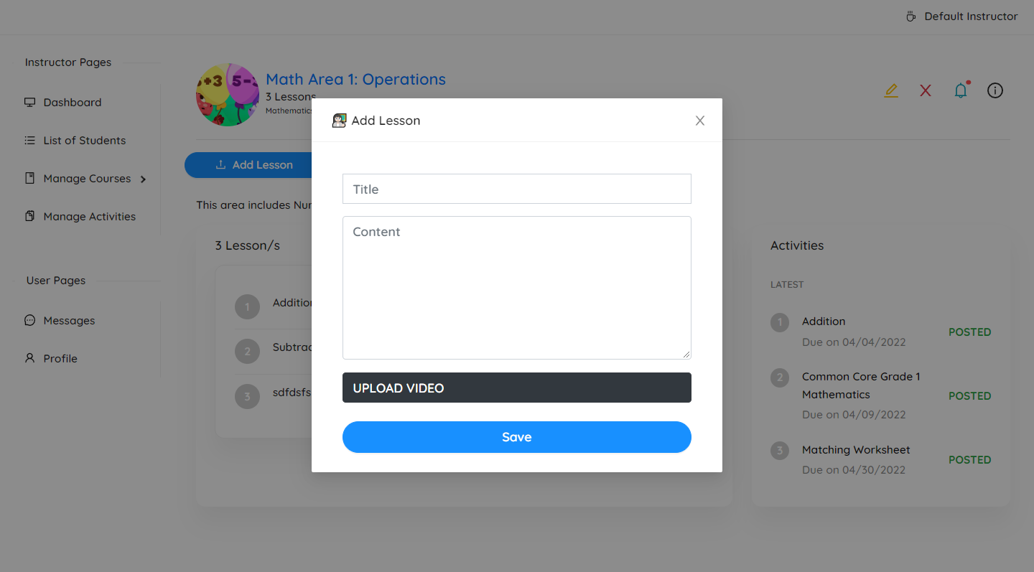
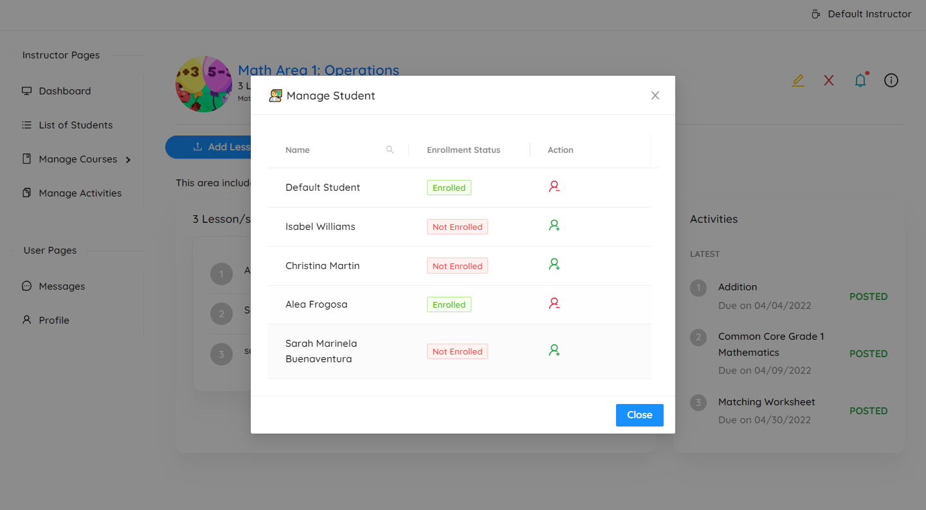
Instructor Pages
Add Lesson Form
Add Student Form
4604
POLYTECHNIC UNIVERSITY OF THE PHILIPPINES

Slide 27
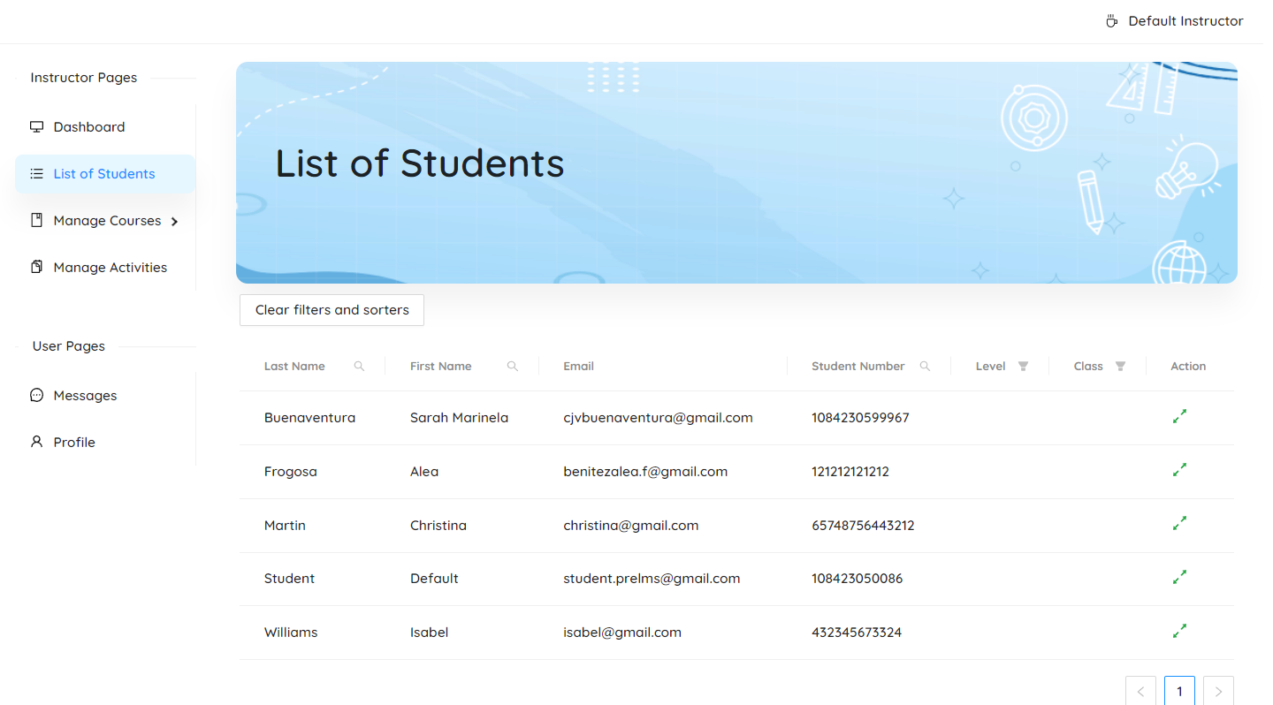
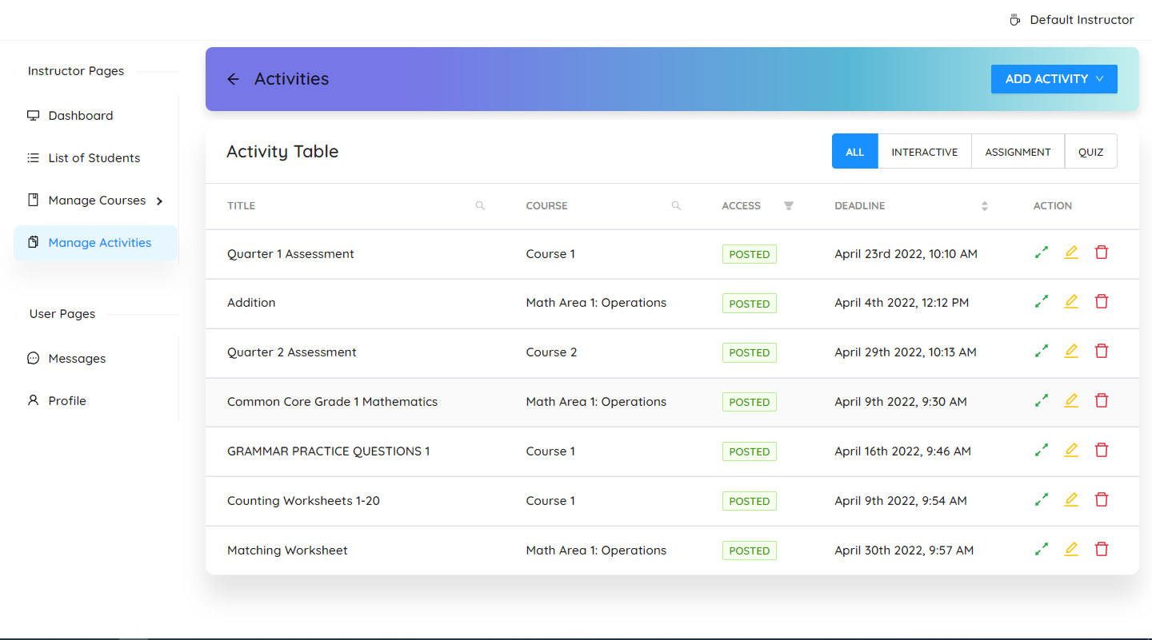
Instructor Pages
List of Students Page
List of Activities Page
4604
POLYTECHNIC UNIVERSITY OF THE PHILIPPINES

Slide 28
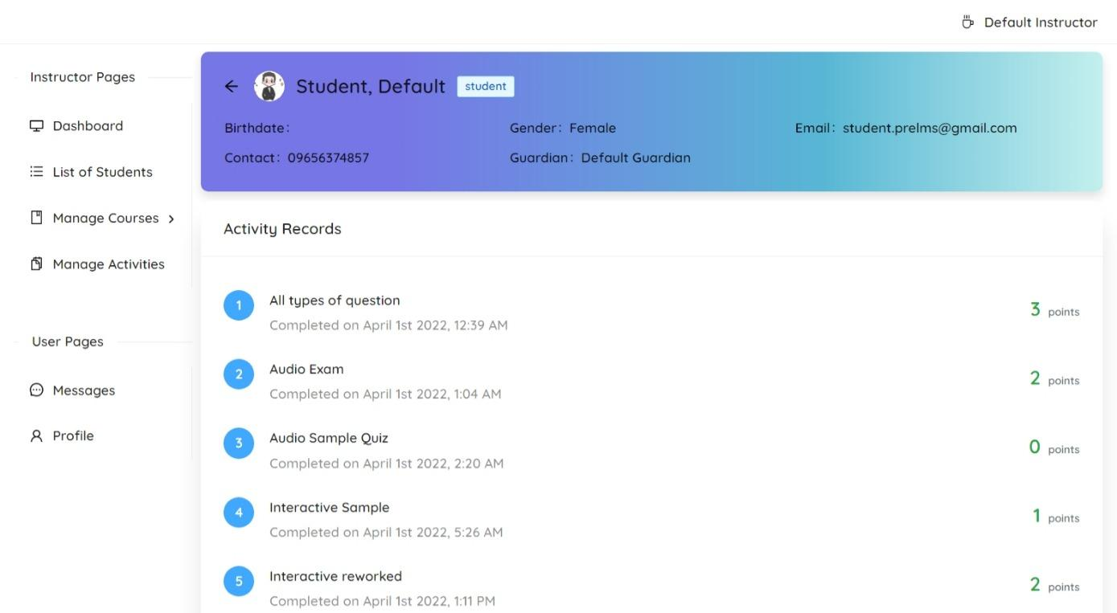
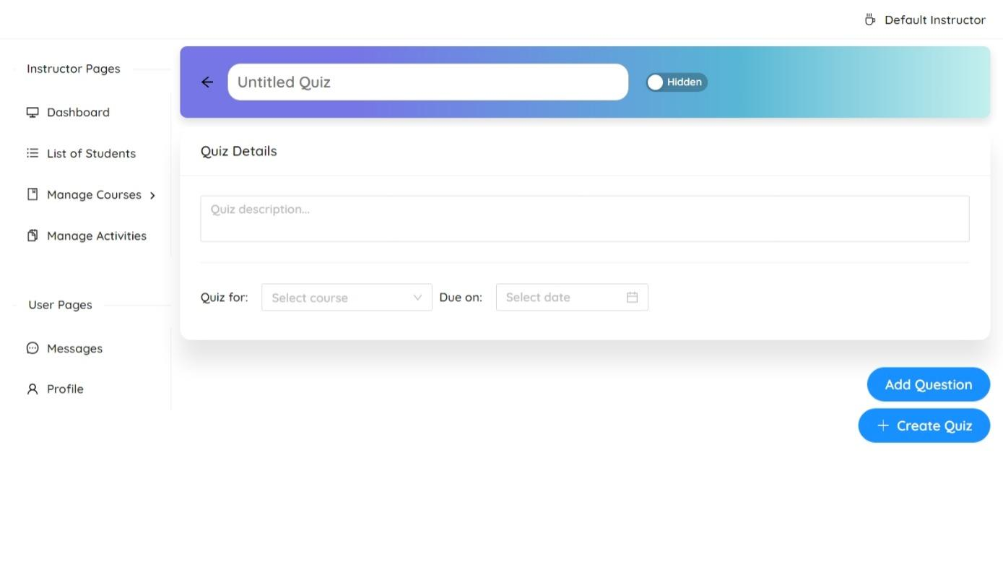
Instructor Pages
Student Information Page
Create Quiz Page
4604
POLYTECHNIC UNIVERSITY OF THE PHILIPPINES

Slide 29
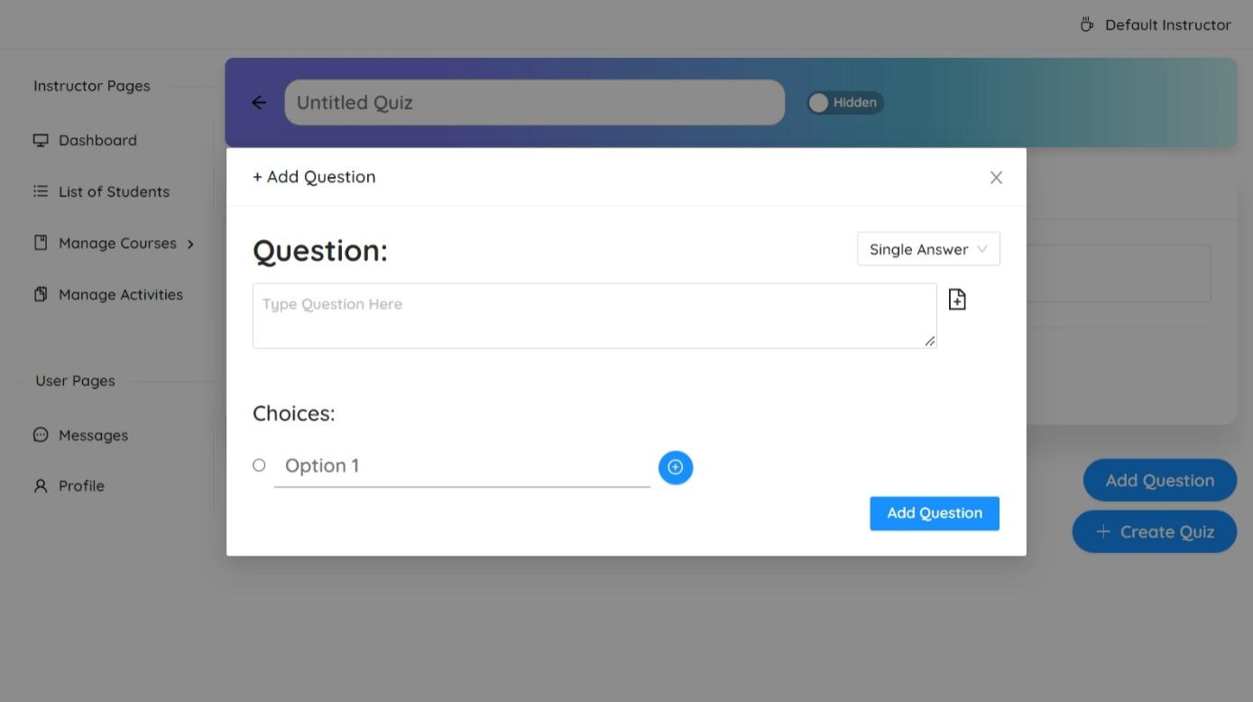
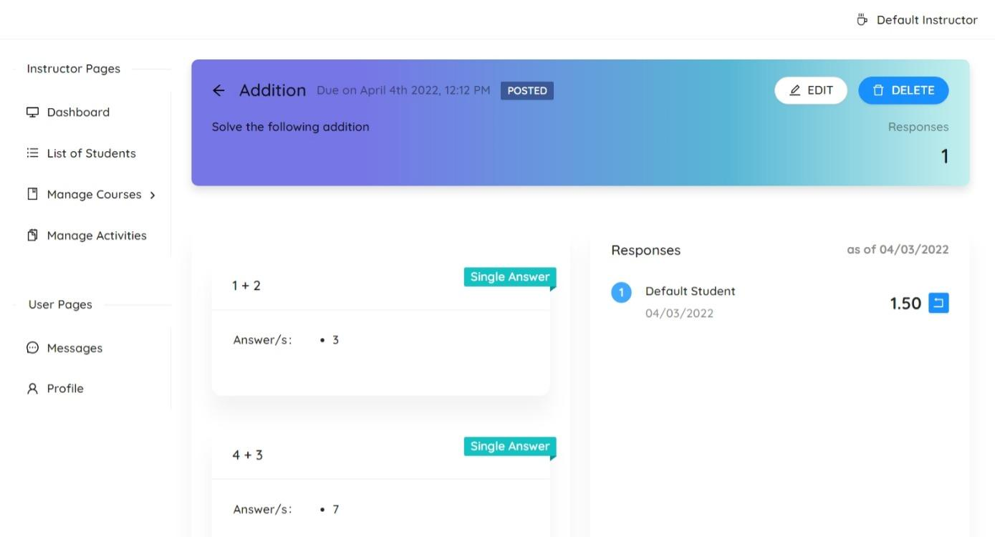
Instructor Pages
Add Quiz Question Modal
Quiz View Page
4604
POLYTECHNIC UNIVERSITY OF THE PHILIPPINES

Slide 30
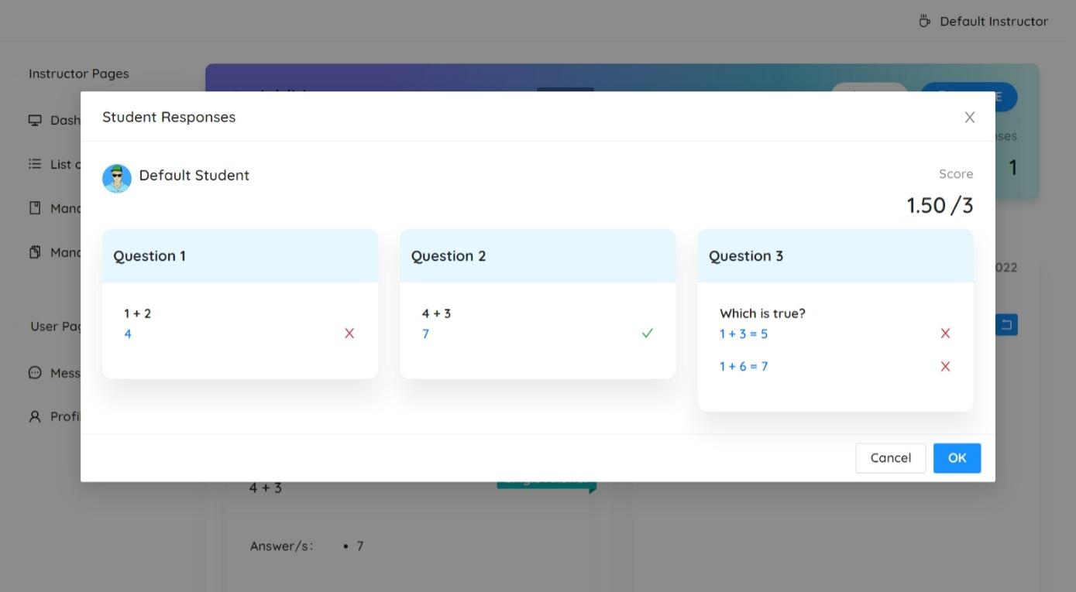
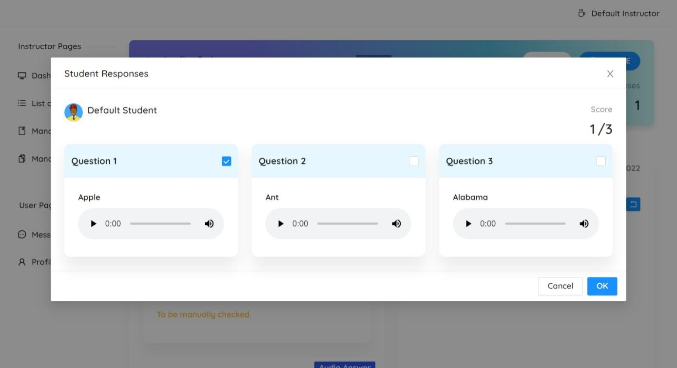
Instructor Pages
Quiz Response Result Modal
Grading of Audio Type Question
4604
POLYTECHNIC UNIVERSITY OF THE PHILIPPINES

Slide 31
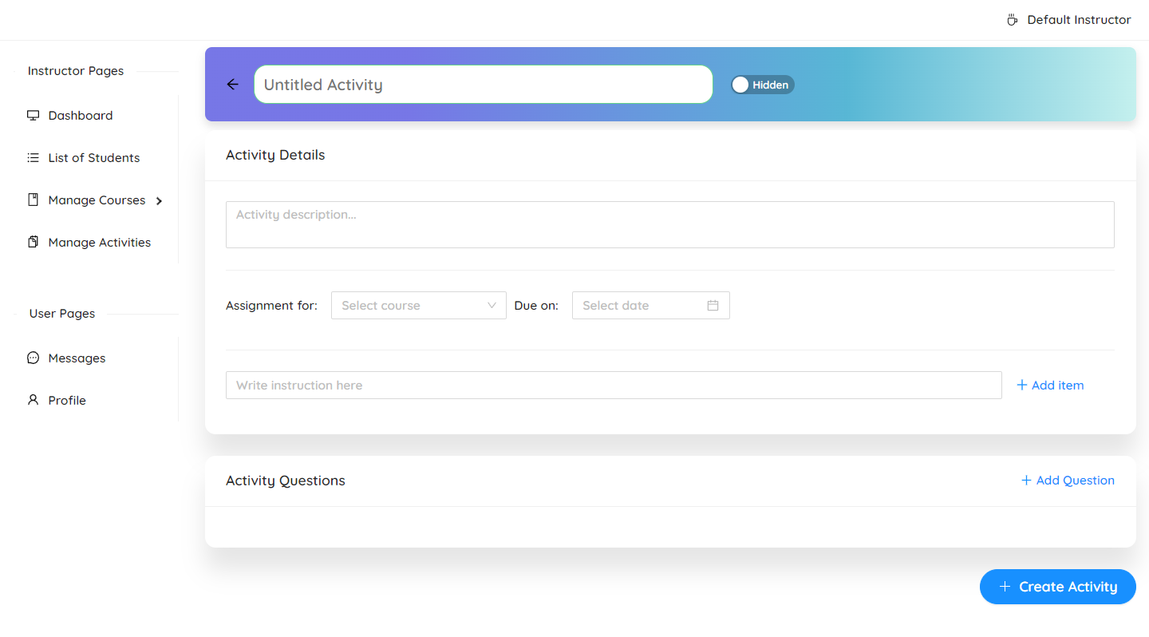
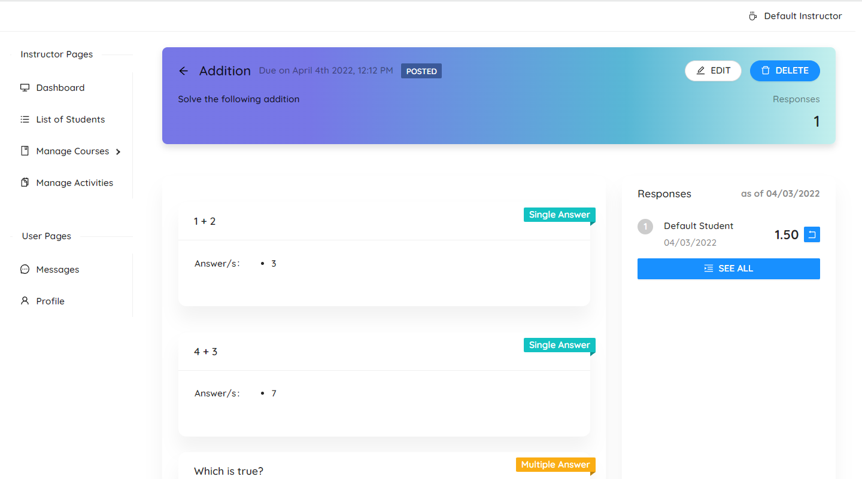
Instructor Pages
Create Interactive Activity Page
Interactive Activity View Page
4604
POLYTECHNIC UNIVERSITY OF THE PHILIPPINES

Slide 32
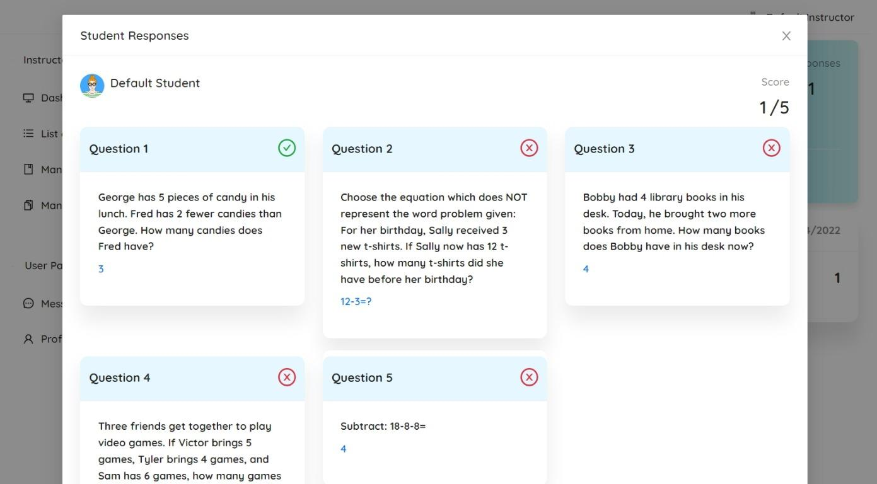
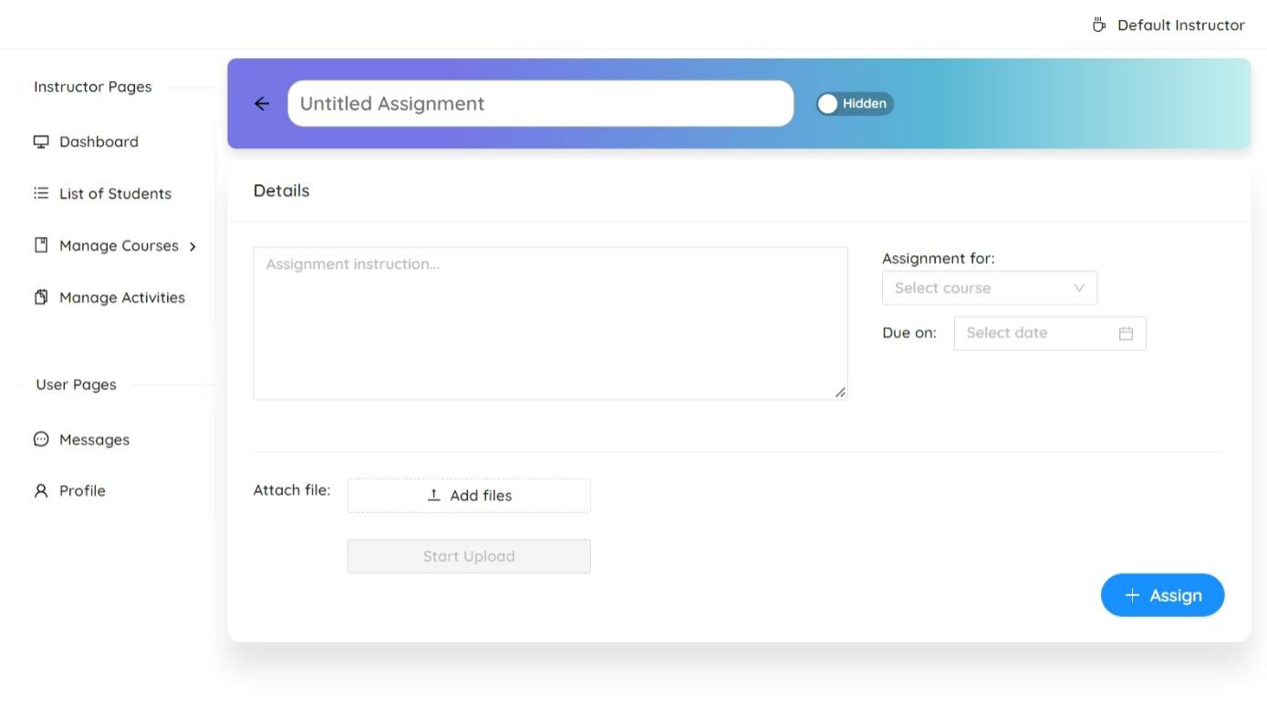
Instructor Pages
View Interactive Activity Response
Create Assignment Page
4604
POLYTECHNIC UNIVERSITY OF THE PHILIPPINES

Slide 33
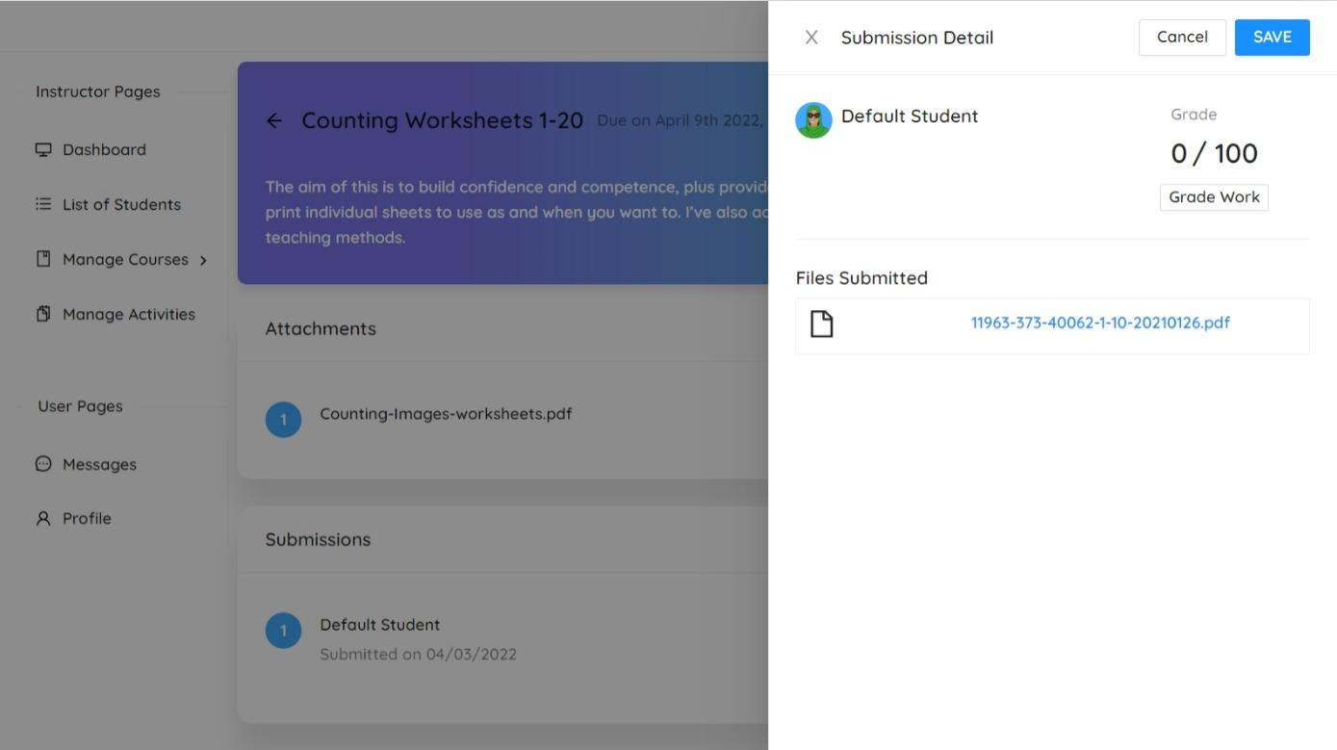
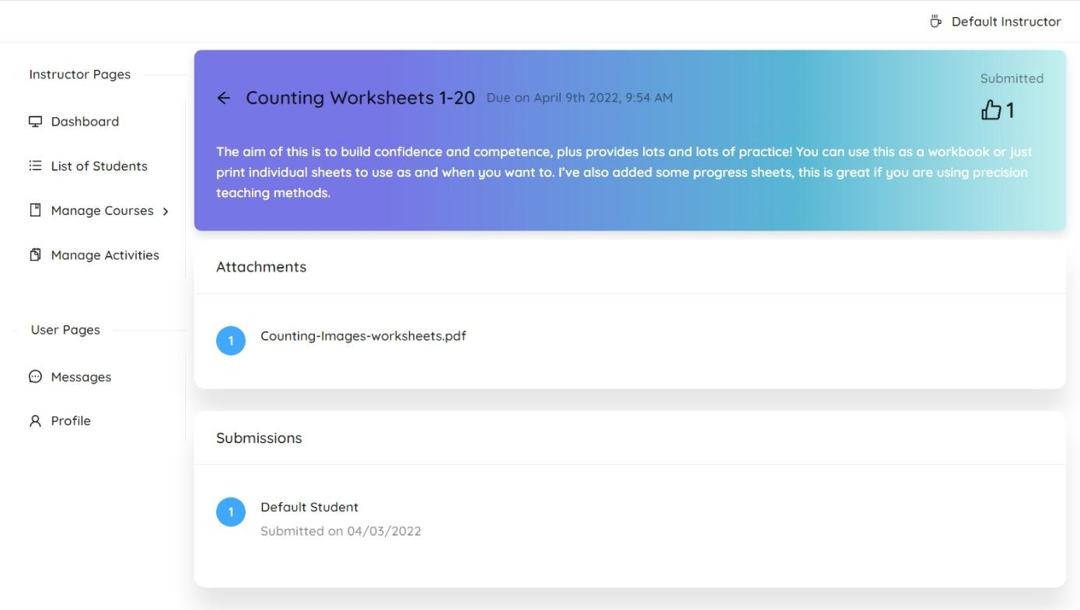
Instructor Pages
Grade Assignment Drawer
Assignment View Page
4604
POLYTECHNIC UNIVERSITY OF THE PHILIPPINES

Slide 34
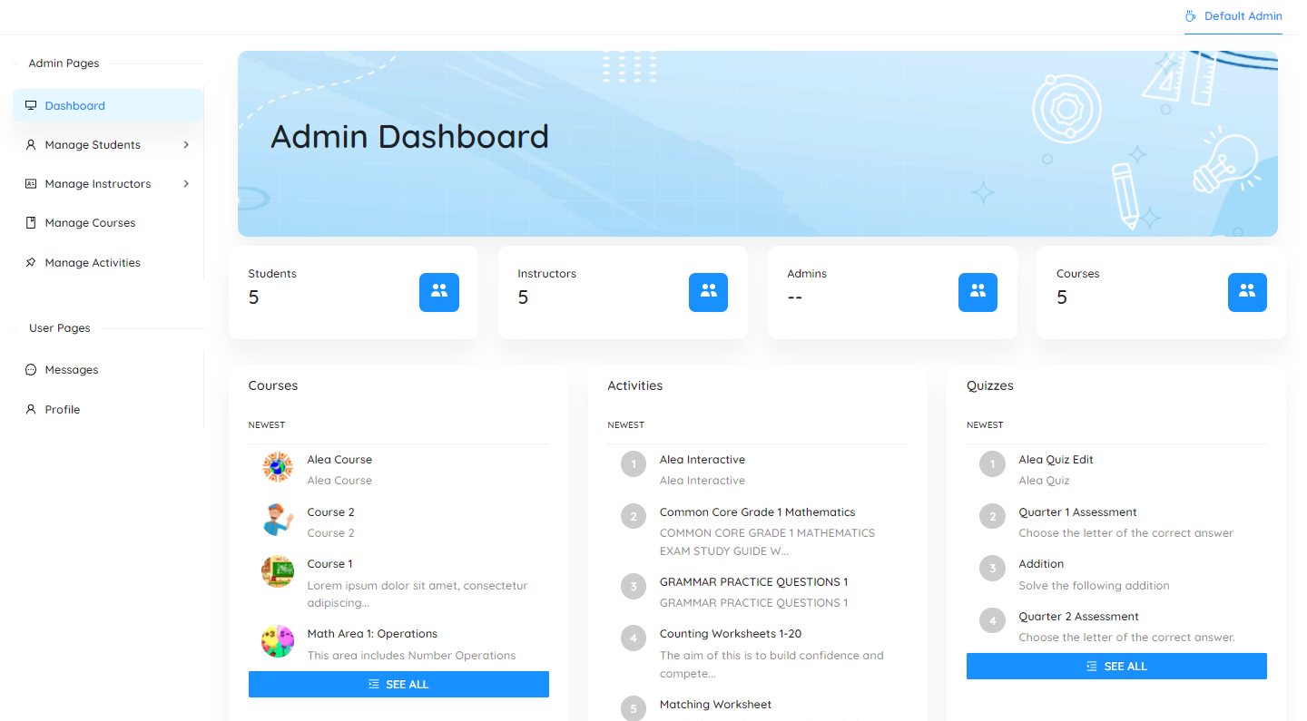
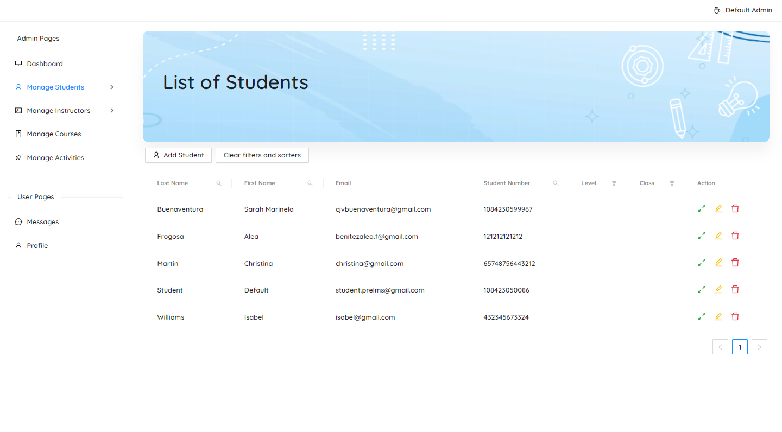
Admin Pages
Dashboard
List of Students Page
4604
POLYTECHNIC UNIVERSITY OF THE PHILIPPINES

Slide 35


Admin Pages
Add Student Page
List of Instructor Page
4604
POLYTECHNIC UNIVERSITY OF THE PHILIPPINES

Slide 36


Admin Pages
Add Instructor Page
List of Courses Page
4604
POLYTECHNIC UNIVERSITY OF THE PHILIPPINES

Slide 37


Admin Pages
Course View
Activities List Page
4604
POLYTECHNIC UNIVERSITY OF THE PHILIPPINES

Slide 38


Admin Pages
Quiz View
Assignment View
4604
POLYTECHNIC UNIVERSITY OF THE PHILIPPINES

Slide 39

Admin Pages
Interactive View
4604
POLYTECHNIC UNIVERSITY OF THE PHILIPPINES

Slide 40



Email
Instructor
Student
Forgot Password
4604

Slide 41
Task Management
4604
POLYTECHNIC UNIVERSITY OF THE PHILIPPINES

Slide 42

Current Board
4604
POLYTECHNIC UNIVERSITY OF THE PHILIPPINES

Slide 43

Target Dates
4604
POLYTECHNIC UNIVERSITY OF THE PHILIPPINES

Slide 44
Challenges
The researchers can’t find any preschool institution to be a beneficiary of the system
The researchers don’t get enough feedback and criticism about their papers.
4604
POLYTECHNIC UNIVERSITY OF THE PHILIPPINES

